Slide 1
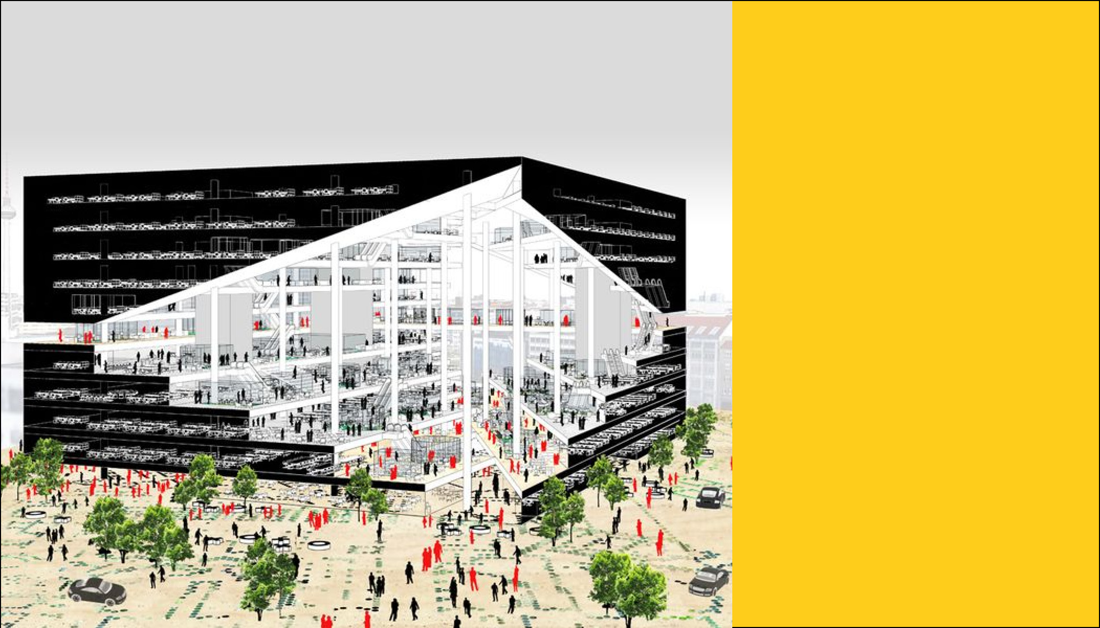
Between Space & Use
Karen Zellner
DAT-NYC-41
Notes:
Optimization of Architecture: An exploration into ways that machine learning and data science can influence architecture planning on a campus scale.

Slide 2
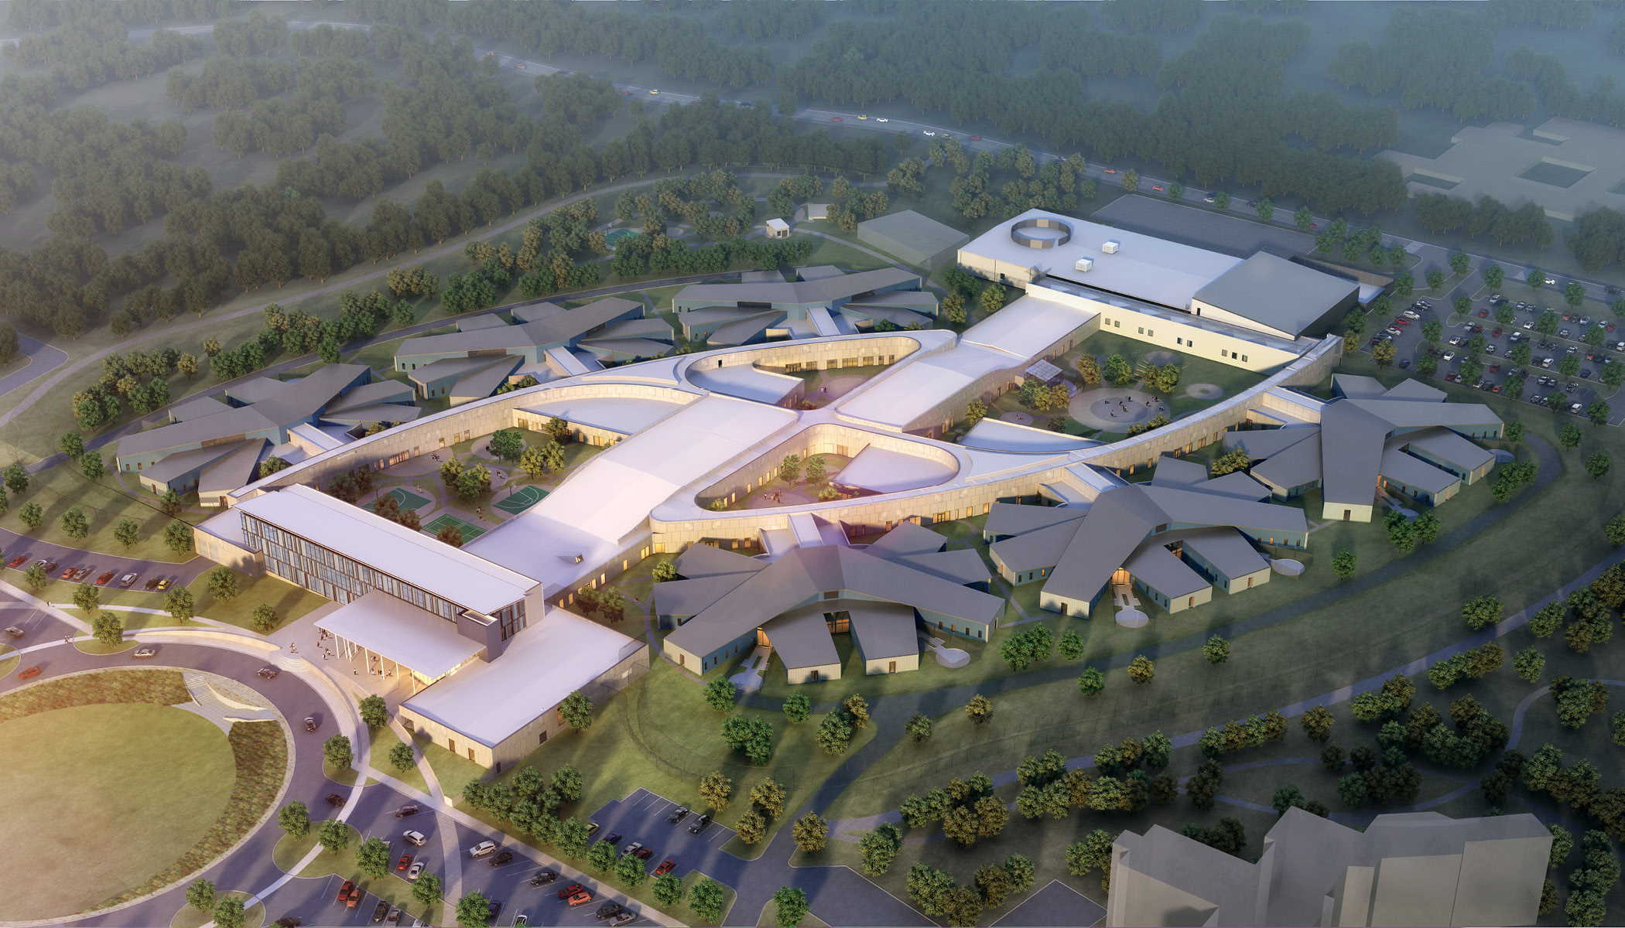
BACKGROUND
Notes:
Personal Background
Challenges faced when applying data science to design – not really applicable for building a classifier model as architecture is more subjective
But using optimization instead

Slide 3

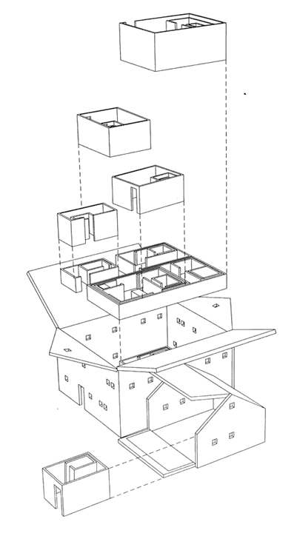
BACKGROUND
Notes:
Goal of project :
What is programming?
2 data sets – Room Inventory & Class inventory (aka Space & Use)

Slide 4
DATA: USE
2239 Courses (after dropping events)
9 semesters
36 Subjects
RmType | Tech | Term | Subject | CourseName
DaysMet | ClassDuration | HoursPerWeek | Enrollment
Building | RmID | SeatCapacity
Notes:
Class inventory – had to drop events (anything with a blank value)
Grouped into semesters
Working w data -prep for analysis - getting hourly performance -splitting up into semesters

Slide 5
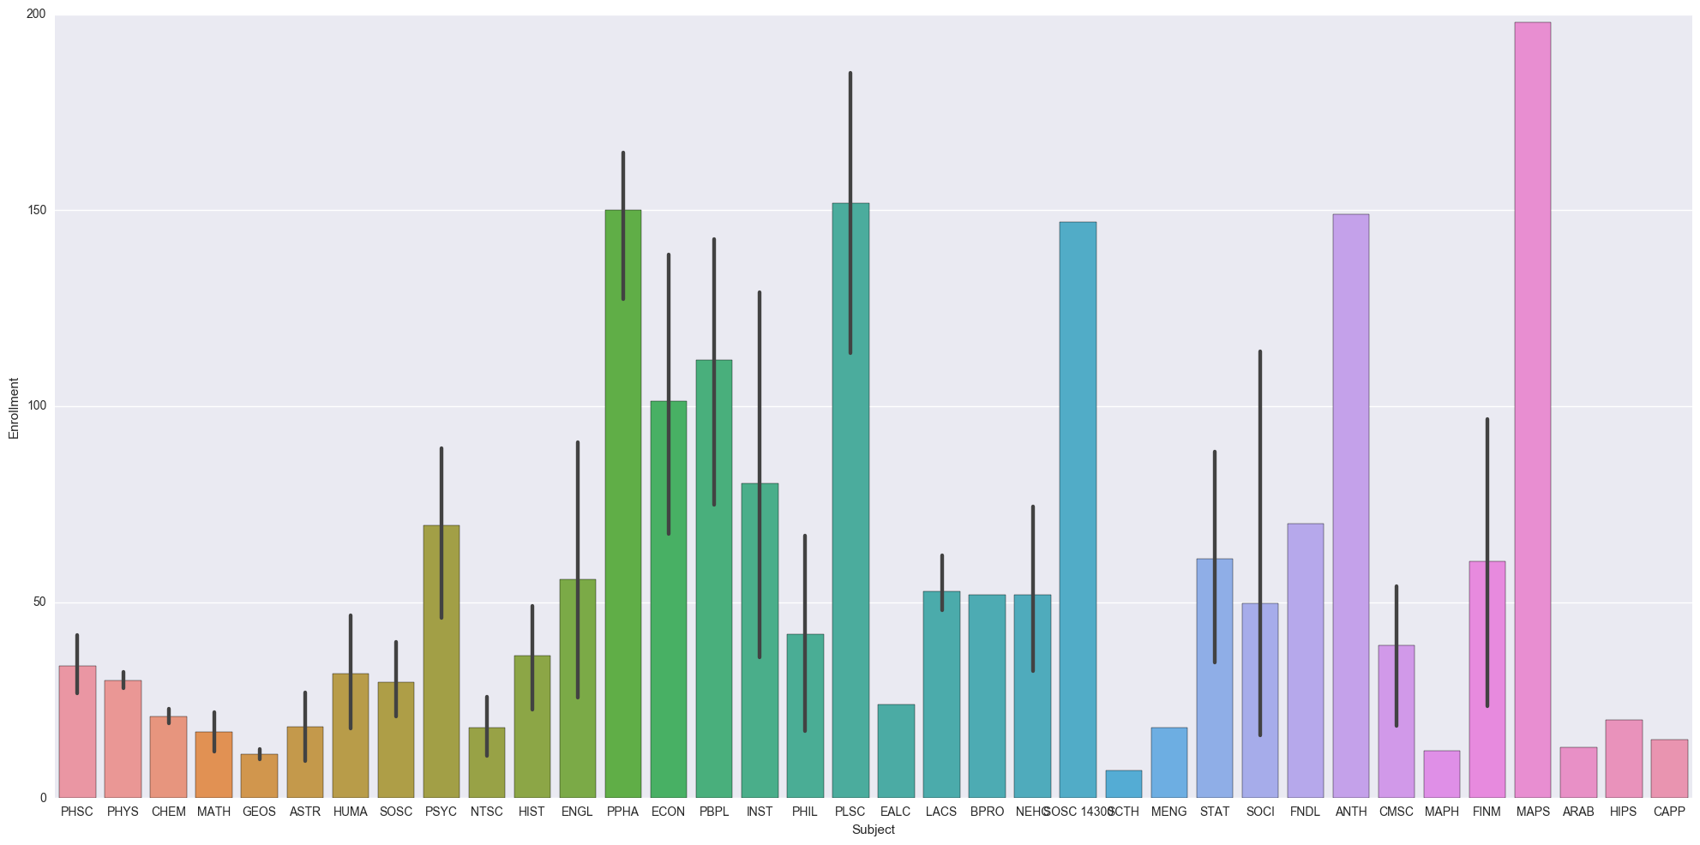
DATA: USE
Mean Class Size (By Dept.)
Notes:
Looking at size of classes for majors- helps identify where particular departments might be better suited for larger facilities

Slide 6
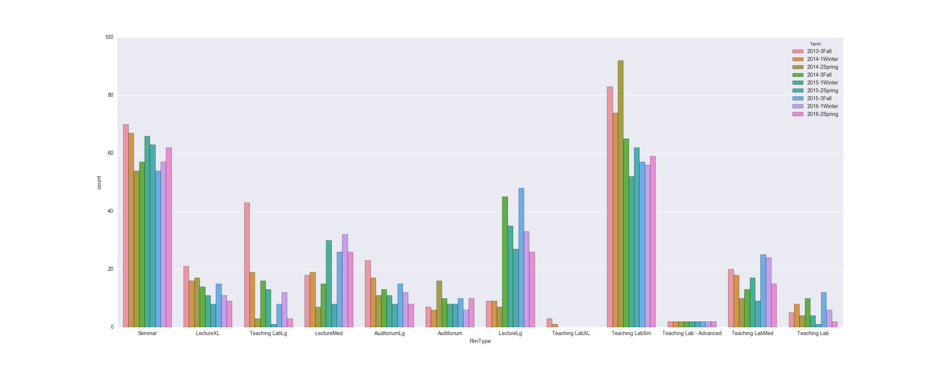
DATA: USE
Count of Room Types Used (By Semester)
Notes:
Indicates how class trends are changing

Slide 7
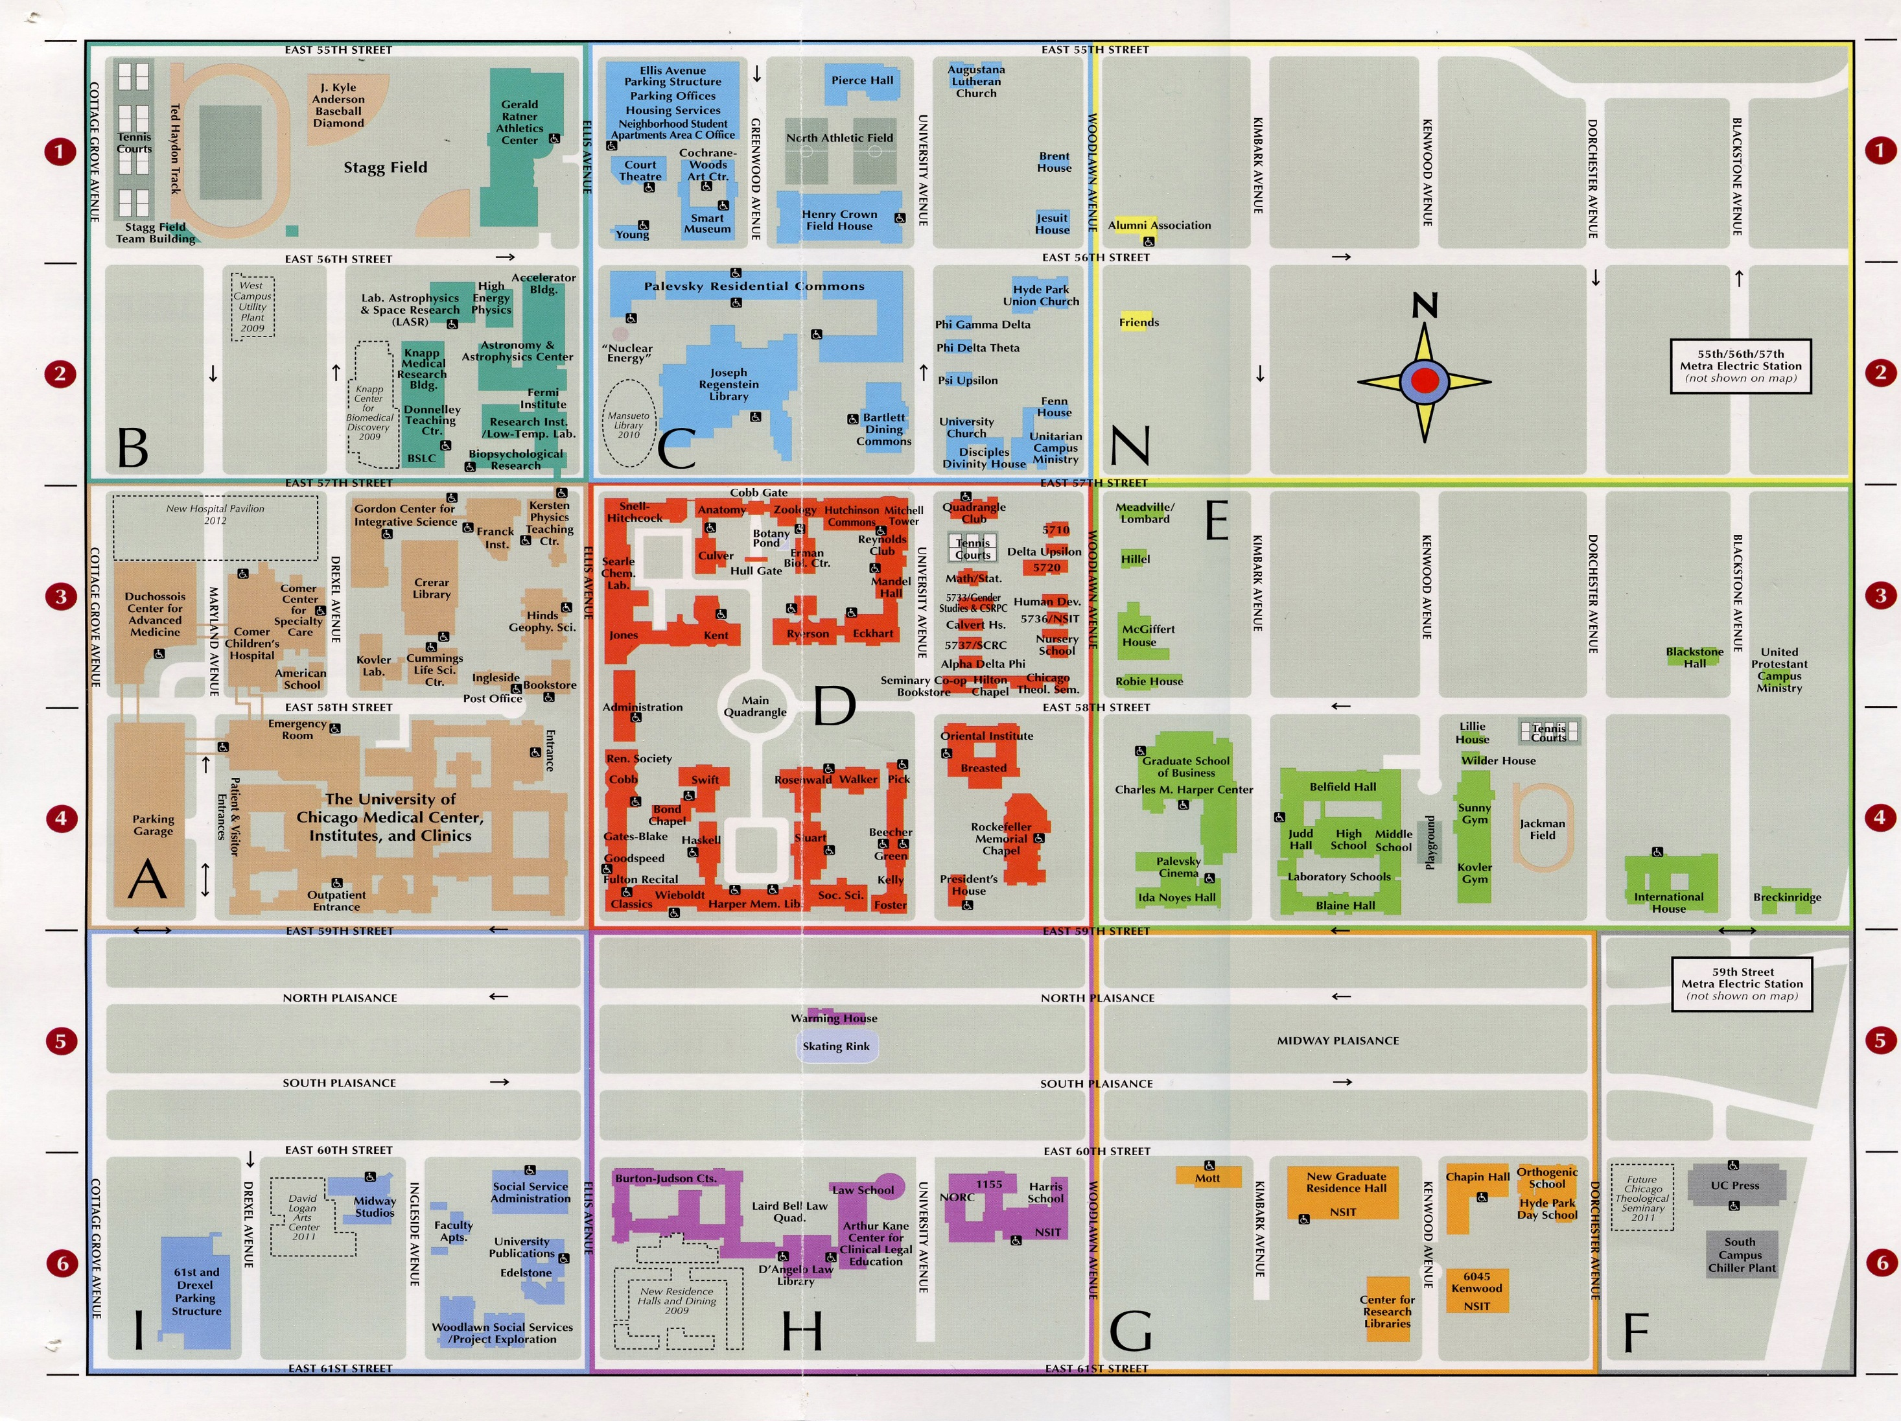
DATA: SPACE

Slide 8
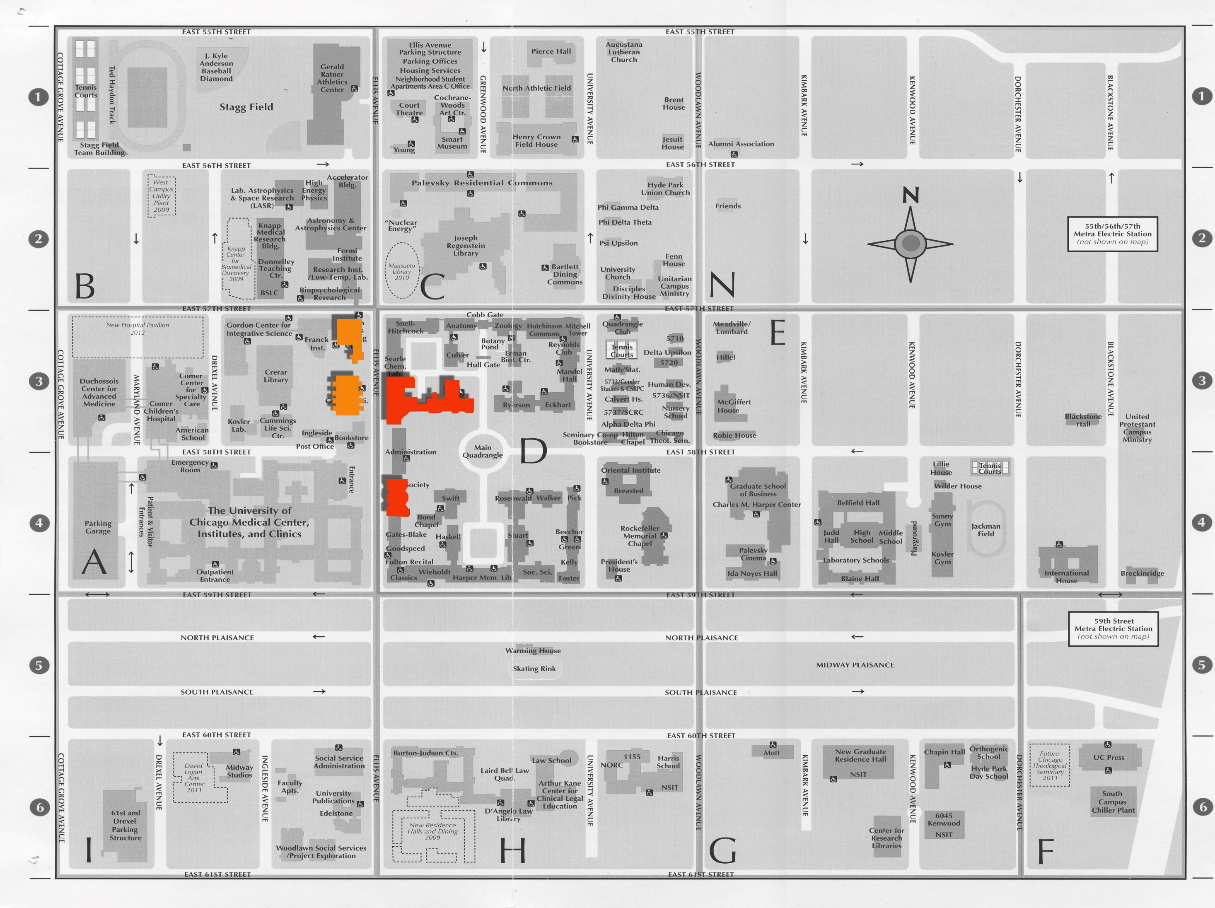
DATA: SPACE

Slide 9
DATA: SPACE
KERSTEN
HINDS
JONES
KENT
COBB

Slide 10
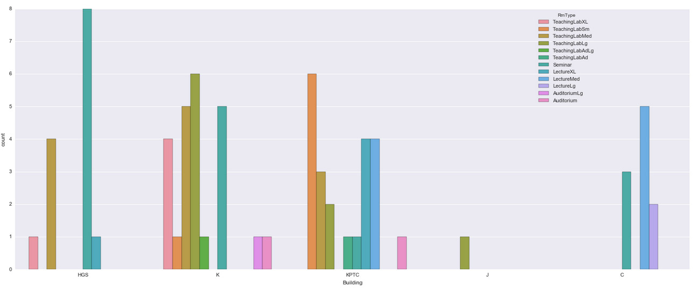
DATA: SPACE
HINDS
KENT
KERSTEN
JONES
COBB

Slide 11
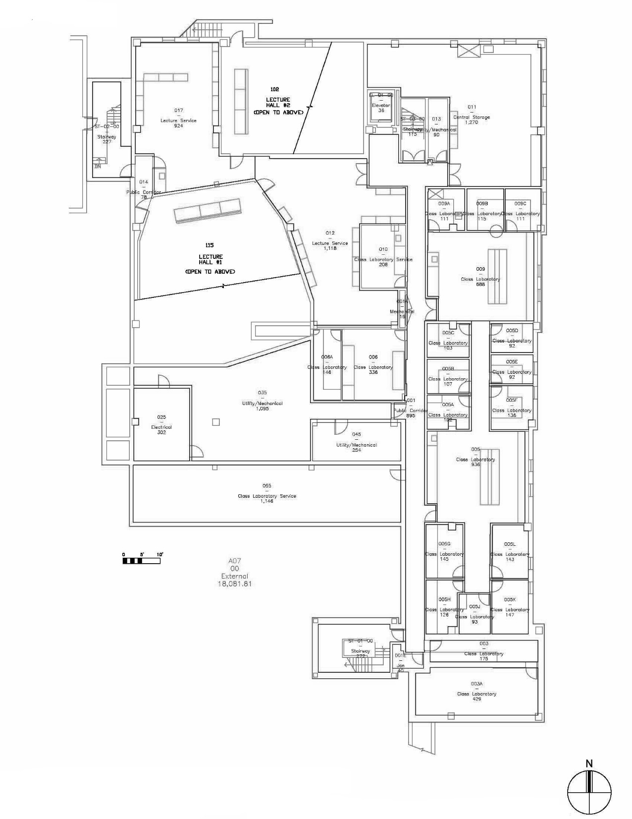
DATA: SPACE
KPTC | KPTC115 | LectureXL

Slide 12
DATA: SPACE
Building | RmID | RmType
Notes:
5 buildings
71 unique room ids
12 room types – this I had to do by grouping similar sized and programmed rooms, could be generalizable for this type of building

Slide 13
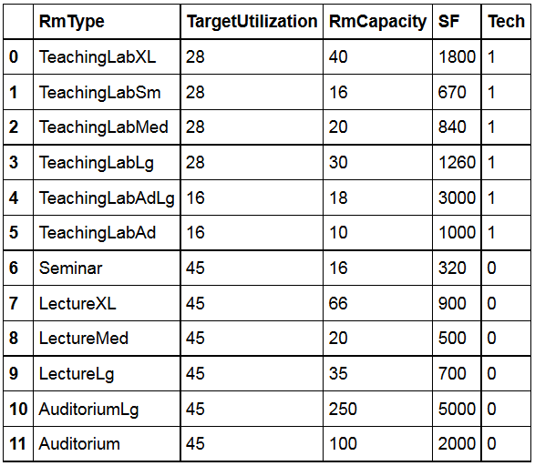
DATA: SPACE
Building | RmID | RmType
Notes:
Room types further define performance requirements
Gives the target utilization which is hours per week the room is intended to be used
Room capacity is how many seats in classroom
Sf lets the building areas be calculated
Tech is whether the space is technical or not

Slide 14
DATA: SPACE
Building | RmID | RmType
Notes:
Room types further define performance requirements
Gives the target utilization which is hours per week the room is intended to be used
Room capacity is how many seats in classroom
Sf lets the building areas be calculated
Tech is whether the space is technical or not

Slide 15
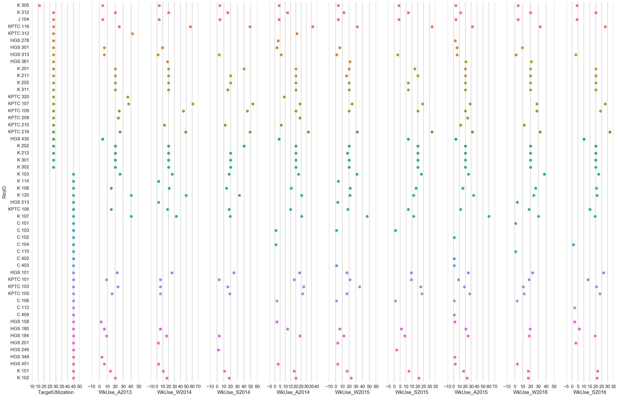
16 HOURS/WK
DATA: SPACE
28 HOURS/WK
45 HOURS/WK
Weekly Room Use In a Perfect World

Slide 16
DATA: SPACE
Weekly Room Use Compared to Target Utilization (By Semester)

Slide 17
MODEL: BINS
ROOMS
1
2
3
4
5
6
CLASSES
A
E
G
B
C
D
F
Notes:
Bin Packing
First fit
Optimize for LEAST amt of bins - Using multiple size bins determine the least amount of containers (in this case rooms) to fit all the courses Attempt 2: Knapsack (Alternate Model) - Using fixed number of existing rooms figure out the most value (well fitting classes)

Slide 18
MODEL: BINS
F
B
D
G
A
E
C
1
2
3
4
5
6
FIRST-FIT
OPTIMIZES FOR LEAST NUMBER OF BINS (ROOMS)
BETTER SUITED FOR NEW CONSTRUCTION
Notes:
Bin Packing
First fit
Optimize for LEAST amt of bins - Using multiple size bins determine the least amount of containers (in this case rooms) to fit all the courses Attempt 2: Knapsack (Alternate Model) - Using fixed number of existing rooms figure out the most value (well fitting classes)

Slide 19
MODEL: KNAPSACK
ROOMS
CLASSES
A
E
G
B
C
D
F
Notes:
Bin Packing
First fit
Optimize for LEAST amt of bins - Using multiple size bins determine the least amount of containers (in this case rooms) to fit all the courses Attempt 2: Knapsack (Alternate Model) - Using fixed number of existing rooms figure out the most value (well fitting classes)

Slide 20
MODEL: KNAPSACK
B
F
G
E
D
A
C
FIRST-FIT
OPTIMIZES FOR VALUE OF ITEMS (CLASSES)
COMPLICATED TO SET UP MULTIPLE KNAPSACKS
NOT GENERALIZABLE
MORE IMPORTANTLY : BEYOND MY PYTHON SKILLS
Notes:
Bin Packing
First fit
Optimize for LEAST amt of bins - Using multiple size bins determine the least amount of containers (in this case rooms) to fit all the courses Attempt 2: Knapsack (Alternate Model) - Using fixed number of existing rooms figure out the most value (well fitting classes)

Slide 21
MODEL
Final Approach:
‘Room Scenario’ is a combination of the 12 room types that ‘fits’ in the square footage of the existing buildings
Exhaustive list was way too many (something like 71! possible arrangements ) so I had to get creative
Figure out the highest hours used in a semester of a given room type (take top occurrence over 9 semesters) → this is the base requirement
Given the amount of space ‘left over’ I can figure out the growth potential (say 10% over 6 years)
Compare the base requirements of rooms to what currently exists. Anything superfluous was converted to ‘flex’ area I could come up with room combos for this flexible space. .. This was about 3k+ combos to review.
Calculate cost of these new spaces. The cost is based on conversion between technical and non-technical space.
Make suggestions to the client!
Notes:
While this requires more computation it requires less set up

Slide 22
MODEL
Scenario X (Future)
20 rooms
7 Non-Technical
13 Technical
23 to 20 rms : 3 Wall Removals →
@ $5k = $15k
3 Technical Rms Added →
@ $20k = $60k
Cost of Scenario X = $75k
Existing
23 rooms
13 Non-Technical
10 Technical
Required(Now)
11 rooms (14 Free)
7 Non-Technical (5 Free)
4 Technical (6 Free)

Slide 23
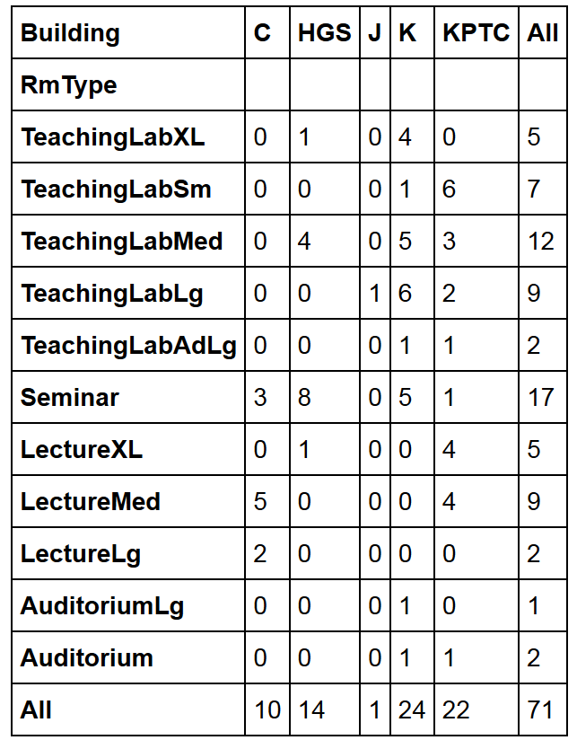
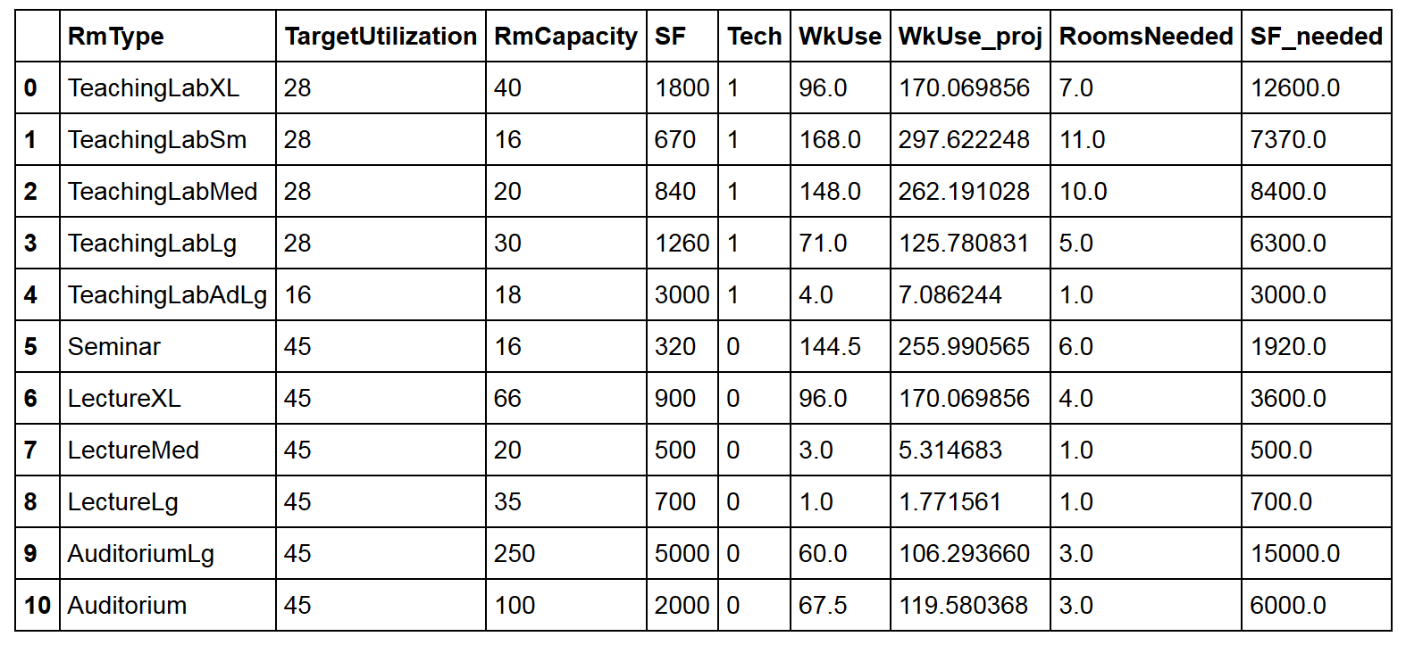
RESULTS
What we have in the buildings…..

Slide 24
RESULTS
What we need in the buildings…..

Slide 25
RESULTS
We only need 51 rooms total to handle the extreme growth… (but there’s going to be a shortage of 2,470 SF)

Slide 26
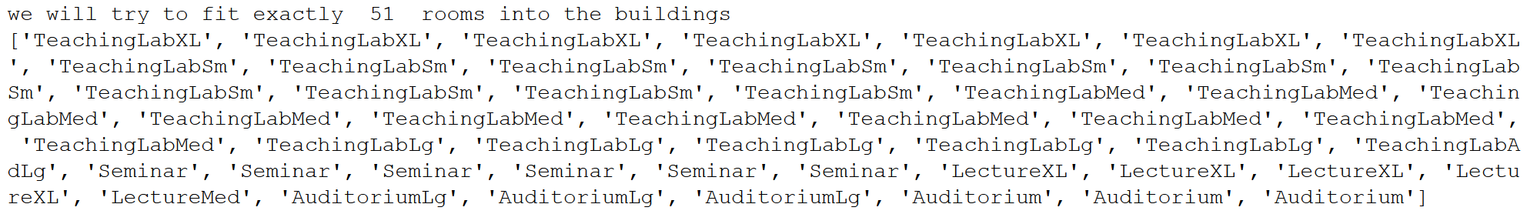
RESULTS

Slide 27
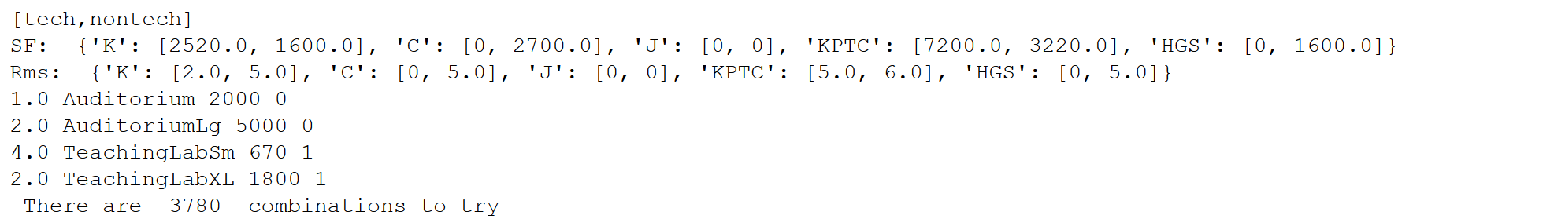
RESULTS

Slide 28
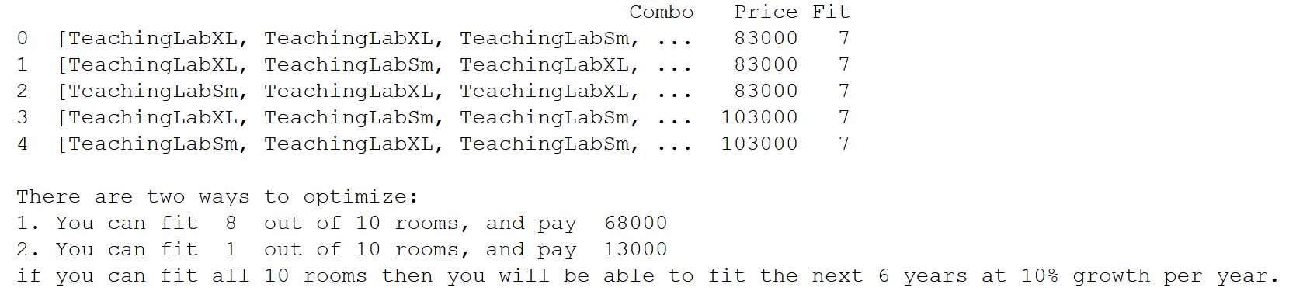
RESULTS

Slide 29
Scoring metrics - Percentage of Seats Filled - Adjacency of classes per department Scope of Model - Extending to additional buildings - Specific growth by department Visualization - Dynamic graphics that update on floor plans - Integration with BIM (3d database modeling) software
NEXT STEPS

